Slide 1
Osmosis
DO NOW: Learning Review
What is the function of the cytoplasm?
Define diffusion.
Explain why a giraffe needs lungs to provide it’s cells with oxygen and remove carbon dioxide.

Slide 2
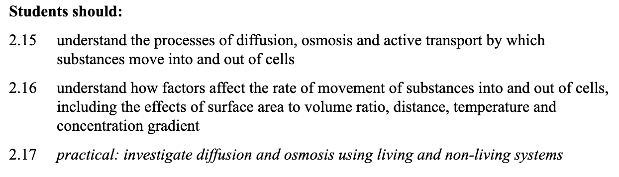
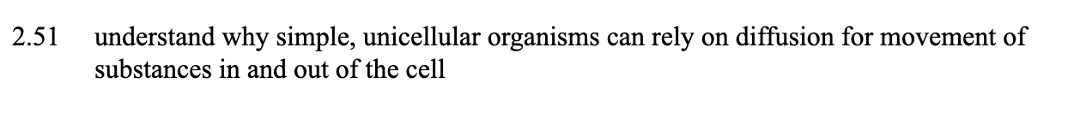
Learning Challenges

Slide 3
water
glucose
Solvent molecules
e.g. water
Solute molecules
e.g.glucose
Water is the solvent used in nature

Slide 4

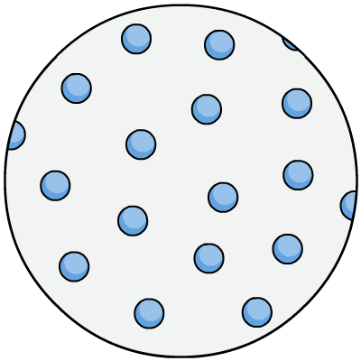
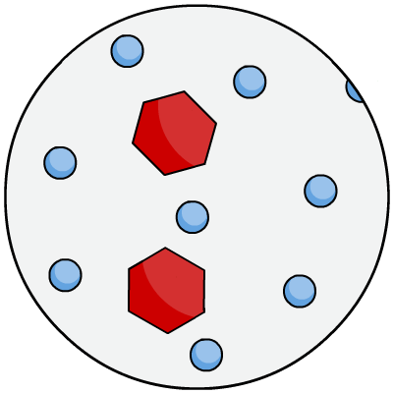
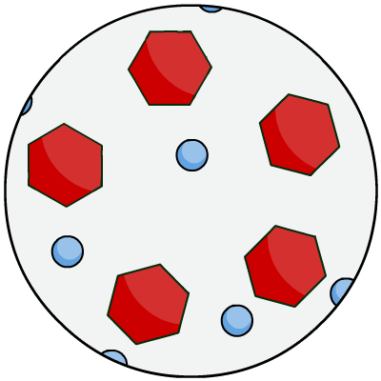
Dilute vs. concentrated
Water (solvent)
Glucose (solute)
Dilute solutions have a high concentration of water molecules.
Concentrated solutions have a low concentration of water molecules.
Task: Draw the three diagrams below labelled A-C, decide which diagram represents a dilute solution, a concentrated solution and pure water
A
B
C
concentrated
solution
pure water
dilute solution
Concentrated solution
Pure Water
Dilute solution

Slide 5
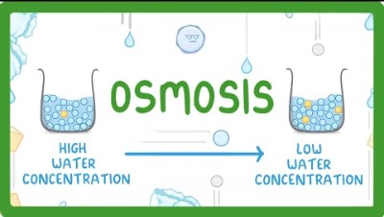
What is osmosis?
https://www.youtube.com/watch?v=vCJVXYmXkzM

Slide 6
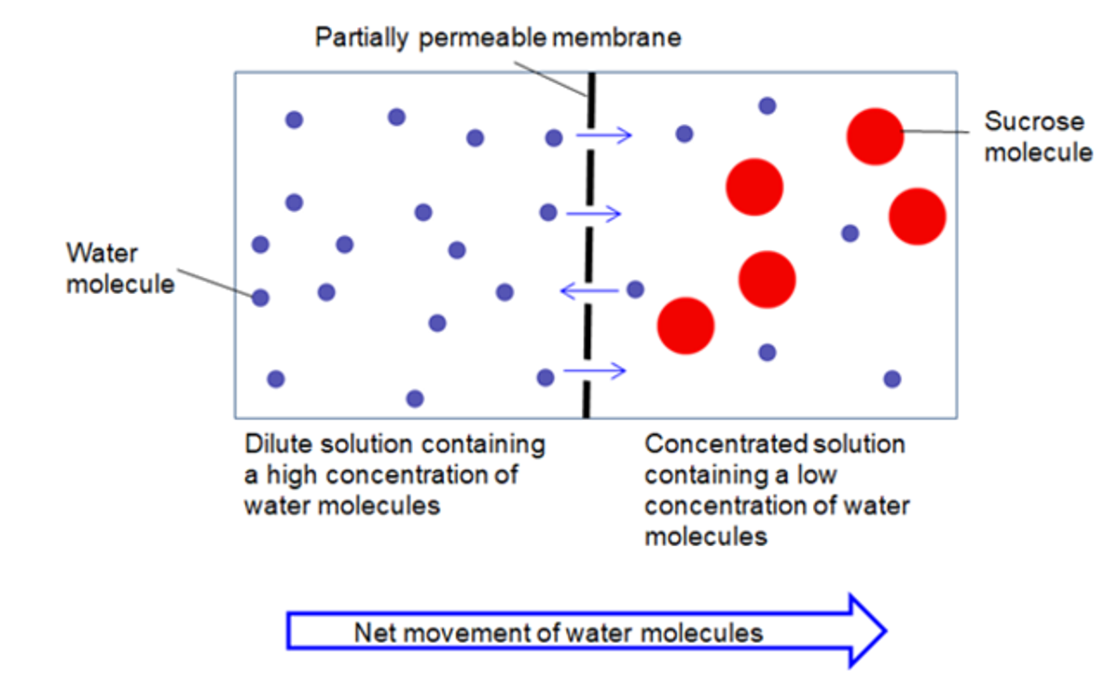
Osmosis is…
… to an area of low water concentration (a concentrated solution) through a partially permeable membrane
… the movement of water molecules from an area of high water concentration (a dilute solution) …

Slide 7
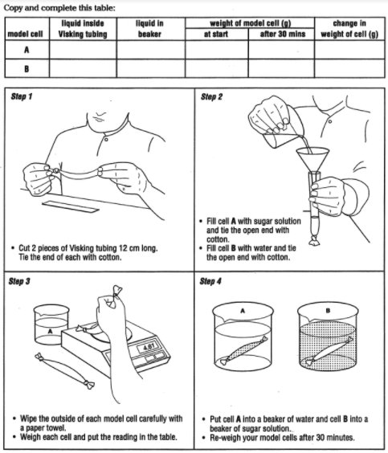
Model Cell

Slide 8
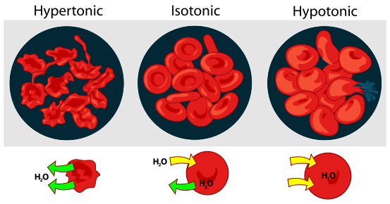
Task: Fill in the cartoon strip to show describe what happens when you place an animal cell into an isotonic (same concentration), a concentrated and a dilute solution.
Key Words
Water
Osmosis
Concentration
Movement
Gradient
Solution
Cell
Notes:
Describe what happens to the cell
Because water moves in/out
Because …..(describe conc gradient)

Slide 9
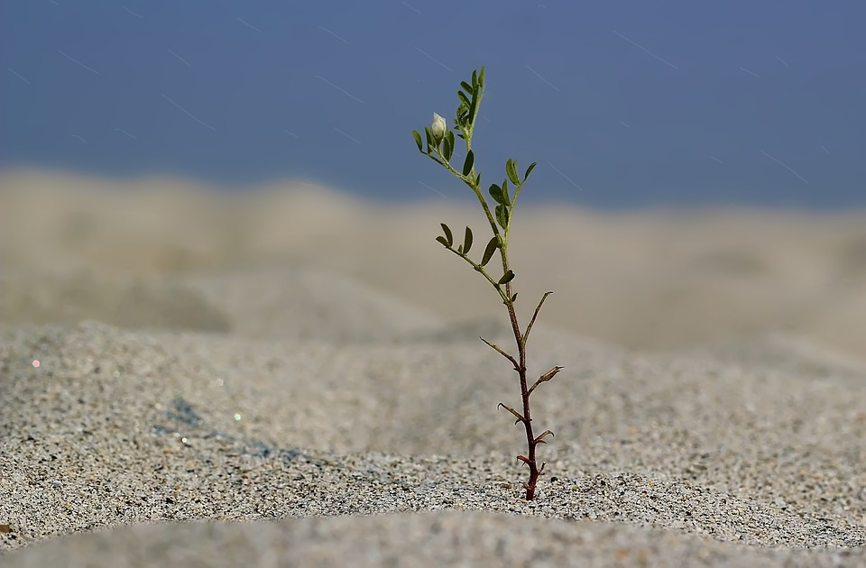
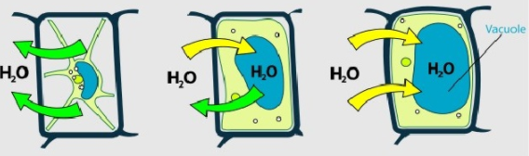
Animal cells are able to control the concentrations of body solutions to prevent cell damage due to osmosis. In plants, osmosis is a vital process which is key to their survival.
Task: Discuss in pairs why you think the movement of water by osmosis is so important to plants
Plants rely on water to support their stems and leaves.
Water enters the vacuole by osmosis, causing the vacuole to swell and push the cytoplasm against the cell wall.
This is known as turgor pressure. This keeps the cells hard and rigid.
Notes:
Pictures: By LadyofHats (did it myself based on [1], [2] ,[3] and [4].) [Public domain], via Wikimedia Commons

Slide 10
Task: Match the diagram to the correct description of how a plant cell behaves in each type of solution:
Plant cell placed in a concentrated solution. This leads to the movement of water out of the cell. This can lead to plasmolysis.
Plant cell placed in a dilute solution. This leads to the movement of water into the cell causing turgor pressure.
Plant cell placed in a isotonic solution. Water enters and leaves the plant cell at an equal rate, this leaves the plant cell flaccid.
Notes:
Pictures: By LadyofHats (did it myself based on [1], [2] ,[3] and [4].) [Public domain], via Wikimedia Commons

Slide 11
Practical Summary
What did cell A look like after 30 minutes?
What happened to the mass of cell A after 30 minutes? Explain what has happened.
What did cell B look like after 30 minutes?
What happened to the mass of cell B after 30 minutes? Explain what has happened.

Slide 12
Practical Summary Answers
Cell A was full of liquid after 30 minutes
The mass of cell A increased because water moved into the visking tube by osmosis from a dilute solution in the beaker (distilled water) to a more concentrated solution (sugar solution) in the visking tubing.
Cell B was floppy and had less liquid in after 30 minutes.
The mass of cell B decreased because water moved out of the visking tube by osmosis from a dilute solution in the visking tube (distilled water) to a more concentrated solution (sugar solution) in the beaker.

